Slide 1
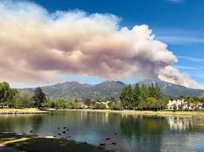
Welcome to the Wildfire Preparedness
and
Home Hardening Presentation
Presented by the Community Associations of Rancho (CAR)
3-14-25

Slide 2
Introduction
This Presentation is part of an effort of the Community Associations of Rancho (CAR) to raise awareness of fire dangers in our community, and efforts that residents can take to protect the lives of their families, their homes, and community, along with sharing homeowner insurance options in high fire danger areas.
CAR is comprised of Homeowner Association leadership from (6) master associations, representing over 16,000 homes and approximately 45,000 residents within the City of Rancho Santa Margarita. It was formed to collaborate with the City and other Agencies on Community and State issues of interest.
This presentation will be made available via email to you if you wish.

Slide 3
So, What Will You Learn Today?
Part 1. Dangers of Wildfires
Causes of Structure Loss during a Wildfire.
Rancho Santa Margarita Wildfire Map.
Emergency Notification Resources.
Part 2. How to prepare yourself and your family for a wildfire emergency.
Emergency Preparedness Supplies to have on hand.
Protection of Important Documents.
Lessons learned from previous Fires.
Having a Family Evacuation Plan.
Part 3. How you can help protect your home by taking measures to Fire Harden it.
Be Fire Safe – How to Fire Harden your home.
How you may be able to receive a reduction on your Insurance Costs.

Slide 4
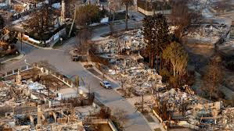
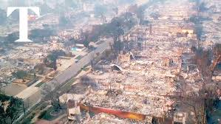
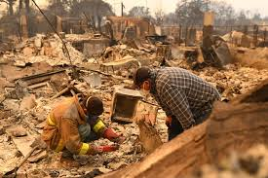
Could your neighborhood look like this following a Wildfire?
Causes of Structure Loss During Wildfires
Unfortunately - Yes!!!!
These pictures are of the 2025 Pacific Palisades and Eaton Fires. There were 6,822 structures destroyed in the Palisades Fire, 9,418 in the Eaton Fire, and 29 people lost their lives. Nothing can prepare you for what took place, but there is a chance, that more homes could have been saved through Fire Home Hardening.
Courtesy Raltor.com
Courtesy You Tube
When we think about wildfires, we generally envision huge walls of flames engulfing homes. The reality is, that most homes do not ignite from direct contact with a flame front. In fact, it’s estimated that 90% of homes are destroyed indirectly by wind-borne embers that are carried ahead of the fire perimeter and enter the home. When the heat generated by an intense wildfire is combined with wind, small burning embers can travel several miles away from the fire perimeter and start a new fire in a different location.
Courtesy The Press Democrat

Slide 5
Emergency Notification Resources
Enroll in Alert OC – It might save your life!
Alert OC, is a county-wide alert notification system that the City of RSM and first responders will be using to communicate to its residents about approaching emergency notifications.
If you are registered, you will find that RSM is divided into 9 zones, so if there is an emergency notification affecting only your zone, you will get specific notifications related only to your zone.
You can Register on your own via the link. www.AlertOC.org
Everyone in the household should register! Make sure you are set up for TEXT MESSAGES.

Slide 7
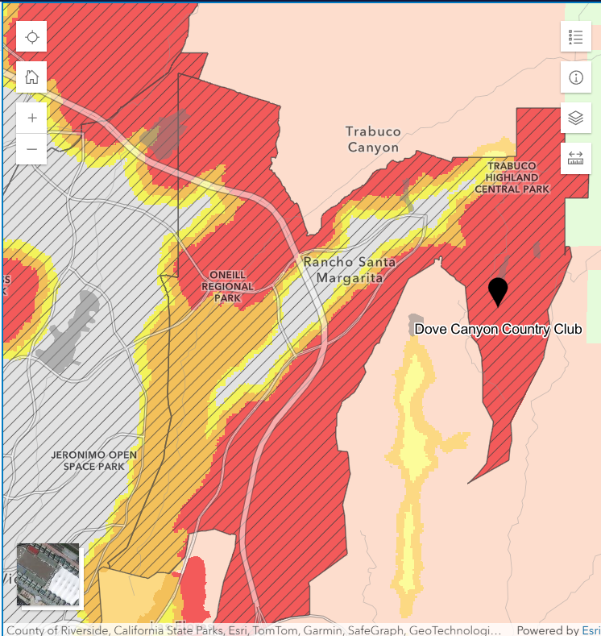
Rancho Santa Margarita
Fire Hazard Zone Map (March 2025)
Some Factors that most impact the severity of a wildfire within our community are as follows:
Lack of Rain.
Lots of vegetation in the Community which can become fuel for fire and structures.
High Wind Conditions.
Power outages that can trap residents in their garages due to being unable to open the garage doors.
Limited routes of entry or egress.
Traffic Congestion, which makes it difficult for residents to drive to a safe location or return to their home.

Slide 9
Emergency Preparedness Supplies To Have On Hand
Don’t get stuck in your garage!
The State of California has legislated that all new garage door openers purchased, and installed, must be equipped with backup batteries. Mainly because some garage doors are very heavy, and you may not be able to lift the door without power.
Electrical utilities have made it a protocol to shut off the power in wildfire prone areas whenever the weather conditions indicate wildfire danger.
In a Battery Back-up opener, when you hear a beeping sound, it is time to replace the Battery. They can be found at Lowes, Home Depot or you can order online.
If your existing opener does not have a battery back-up, back-up devices can be purchased online.

Slide 10
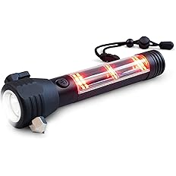
Emergency Preparedness Supplies To Have On Hand (Cont’d.)
It is critical to have emergency lights which activate when you have a power outage. Remember, the utility company will cut off power in heavy wind conditions. Make sure you have emergency lighting available in all areas of the home.
The Amerelle LED Emergency Light can also be used as a Flashlight. You can purchase from Amazon.com.
The Enhon 4 in 1 LED Rechargeable Plug in Flashlight is a LED motion sensor nightlight, emergency light, flashlight, and rechargeable torch light. You can purchase from Amazon.com.
There are many other models available at Lowe’s, Home Depot, Amazon.com
The 4Patriots Solar Rechargeable LED Flashlight, charges by USB or the sunlight.
It can charge your phone, etc. in a pinch and its waterproof. It has a built-in Seatbelt & Rope Cutter, Glass Breaking Hammer, and Compass. You can purchase from 4Patriots.com or Amazon.com.

Slide 11
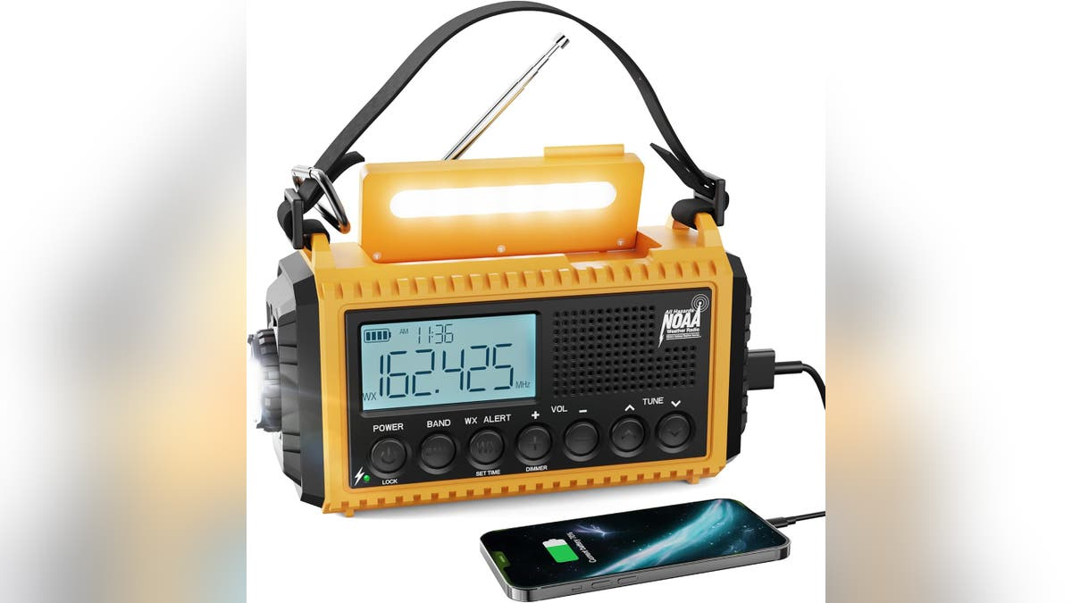
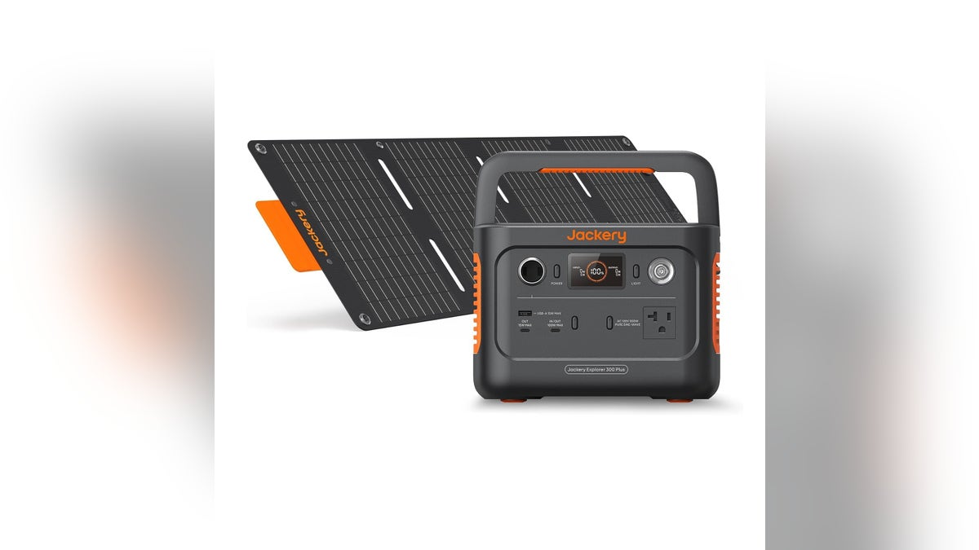
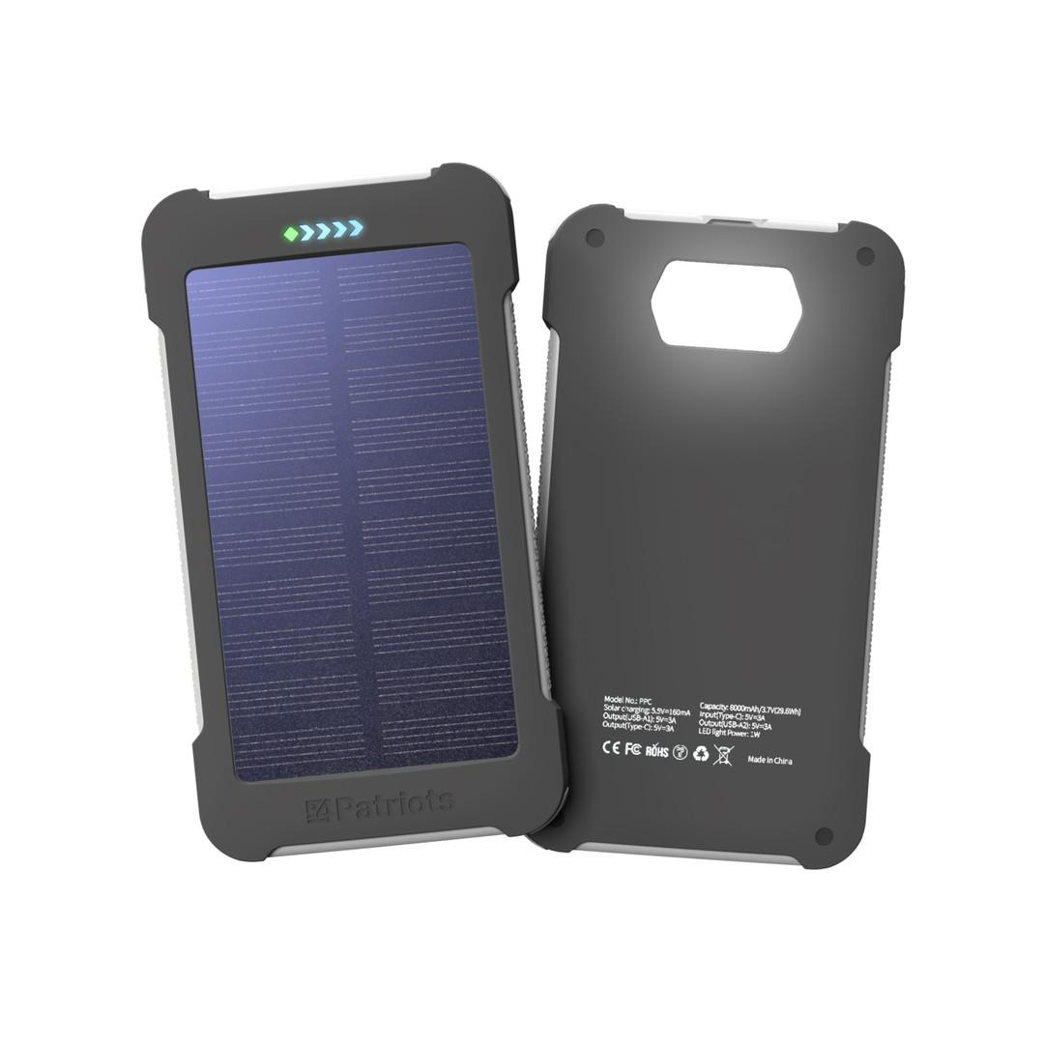
Emergency Preparedness Supplies To Have On Hand (Cont’d.)
An emergency weather radio is battery- operated and automatically scans for emergency and weather-related alerts. It also includes power ports, so you can charge your phone if you lose power. Find affordable weather radios at Home Depot or Amazon.com.
A solar generator by Jackery or other companies, offers power even if your power goes out. This solar generator comes with a foldout solar panel that can quickly charge the generator. It has multiple different power ports, so you can attach your phone charger, extension cords and more. You can purchase from Amazon.com
Cell-CX Portable Solar Power Bank by 4Patriots
This power bank has (2) USB-A Ports and (1) USB-C Port and can charge (3) devices at once. It is also waterproof. You can purchase from 4Patriots.com.

Slide 12
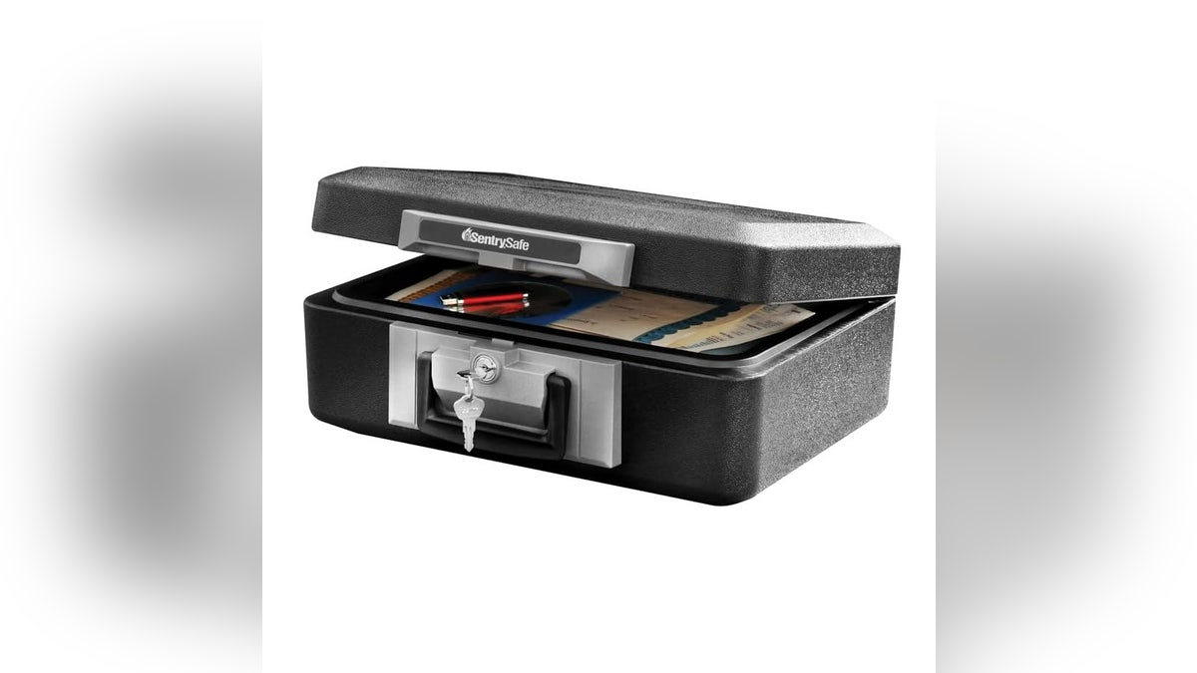
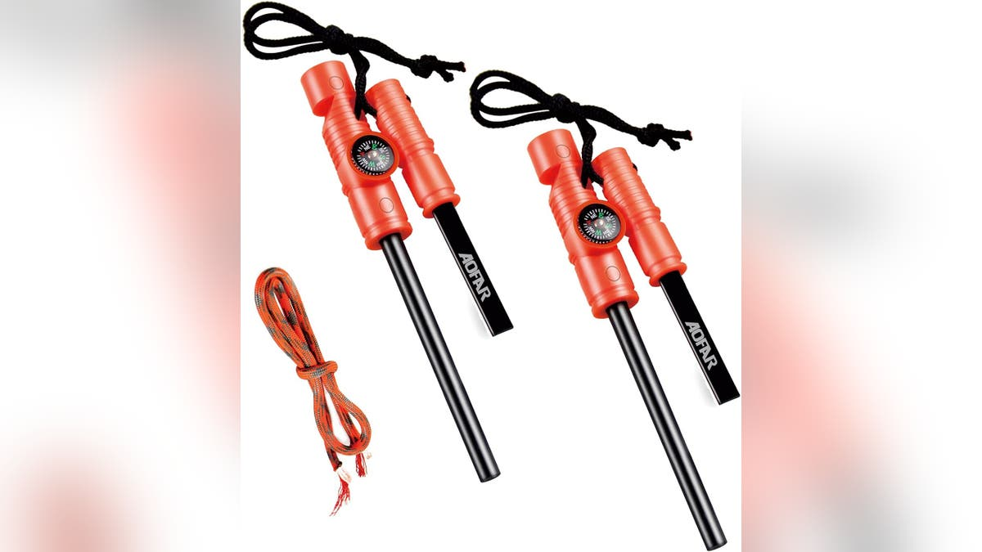
Emergency Preparedness Supplies To Have On Hand (Cont’d.)
SentrySafe Fireproof Safe Box with Key Lock, Chest Safe with Carrying Handle to Secure important documents, etc.
AOFAR Fire Starter AF-381/AF-381plus Fire Steel with Paracord and Whistle for Camping, Hiking, Hunting, Backpacking, Boating, Emergency Rescue…
Ready Hour emergency meal entrées:
This Ready Hour Emergency Rations Bucket includes multiple freeze-dried meals, up to 120 servings.
Earth Pak Waterproof Dry Bag with Zippered Pocket Keeps Gear Dry
Protect Your Gear: Constructed from commercial-grade 500D PVC for high performance, durability, and protection. This wet bag waterproof backpack has a Waterproof Phone Case as well.

Slide 13
Emergency Preparedness Supplies To Have On Hand (Cont’d.)
The “Go Bag”
“Go Bags”, are Backpacks filled with essential items you will need to evacuate your home in an emergency, and needs to be “ready to go”. Placed in an easily accessible location (like the trunk of your car), is a great place to keep it.
You can also customize your Go Bag by adding:
Prescription Medications / Glasses / Contacts
Extra Keys
Bottled Water
Children’s favorite toys
Pet Food and medicines
Credit Cards / Check Book / Cash
N95 Masks
Map with Evacuation Routes
A Multi Tool Pocket Knife
ZIP/USB drive with essential information from your computer which should include pictures of items in your home.
Please Note: Providing product information on the suggested supplies, is not considered an endorsement by this group, but strictly for informational purposes only.

Slide 14
Protect your Important Papers, Documents and Photos
Consider digitizing technology such as Dropbox, iCloud, Zip, and USB drives to protect your important information and documents.
Include the following:
Family Photos
Deeds, Wills, and Trusts
Taxes and Bank Accounts
Pictures of your home and contents for Insurance Purposes.
Address Books
Prescriptions
Make a Video of the contents of the inside and outside of your home before disaster hits. Go room to room and don’t forget inside the cabinets as well.
See: https://www.insurance.ca.gov/flipbook/Home-Inventory2020/
Use an external Back-Up Drive to store your important computer documents.
If you are not comfortable placing information in the icloud, put it on a Zip, Flash, USB, or External Drive, and place in a secure location.
DO IT NOW, instead of when you are evacuating!

Slide 15
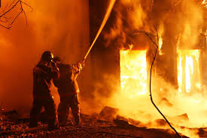
Lessons Learned from Previous Fires
Don’t be a Hero! Fighting Fires should be left to the professionals. Do you know what temperature a wildfire can be? Wild Fires can reach up to 2,000° F, add water, and you create steam which can severely injure you.
Don’t Stay! Evacuate before you are told, and definitely when instructed by Authorities, so as not to be caught in traffic congestion, and because hotels will fill up fast both in and out of the immediate area.
Make sure you:
Always keep your Go Bags in your cars.
Plan for your Pets, take Food, Medicines and Toys in an additional go bag.
Have a full tank of gas in your cars, and your electric cars are charged.
Always have Cash, as ATM systems could go down when power is lost.
Receive Texts and not email alerts on ALERT OC.
Download the WatchDuty App., for constant updates.

Slide 16
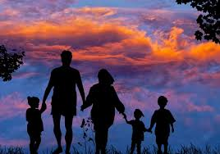
Family Evacuation Plan
Having a Family Evacuation Plan is critical to maintaining communication with all members living in the home. Whether they are at home or not at the time of an evacuation, your plan should include:
A place outside of the danger zone to meet, such as a local Shopping Center parking lot or restaurant.
Plan for your Pets. Who can evacuate them if you are not home?
Choose someone who does not live with you so all members in the home can connect with them to let them know where you are. Example, a sister/brother who lives out of state.
Check on neighbors, especially elderly ones and give them a hand if you can.
What happens if you can’t get back into the community during an evacuation? Traffic, Congestion? In the Airport Fire, residents had to park in the Smart & Final Shopping Center and walk home.
Before evacuating, if time permits, use a Gas Shut off tool to shut off the Gas line at the meter, and if you have propane tanks outside, bring them inside your house. Left outside they could explode and start a fire.
Remember, being prepared is always key to a great PLAN!

Slide 17
Be Fire Safe – How to Fire Harden your Home
Please visit the website BEFIRESAFE.org on tips on Evacuation Preparedness and Home Hardening. Links to other resources: OCFA, ALERTOC, California Fire Safe Council, RSM Voice and Firewise USA

Slide 18
Why is this one home still standing?

Slide 19
Home Hardening Assessment
This is an actual home assessment done in person by OCFA in February of 2023. It lists recommendations to the Homeowner, of what they should do to fire harden their home.
It is free and confidential.

Slide 20
Garage Vents
This HomeOwner had Vulcan Vents put in at Foundation level and below the Eaves. The 1/8-inch Ember Mesh provides a physical barrier for maximum ember protection.
Eave Vents
These vents were retrofitted over the existing vents with 1/8 - inch mesh which still allows airflow. In addition, the use of baffle mesh becomes a fire wall when you need it the most.
During a wildfire, flying embers become the major source of ignition. Carried by the wind, embers enter the homes through Eaves, Attic and Foundation vents. It’s estimated that 90% of the homes destroyed during wildfires are due to internal wind-blown embers.

Slide 21
Enclosed Eaves
Enclosed eaves, are an overhang finished with a soffit.
They prevent heat and embers from getting trapped and igniting.
This picture shows an enclosed eave and ember protected vents.

Slide 22
This slide shows you a better picture of the different types of vents.

Slide 23
Open Eaves
With an open eave condition, inspect eaves for gaps around the rafter roof tails and blocking. Plug or Caulk any gaps with an exterior silicone caulk made for wood use.
Check inside the attic for any daylight that may be coming in where the rafters meet the roof edge and plug or caulk these areas.
If possible, enclose eaves by installing soffit panels.

Slide 24
Roof Vents
Ember Resistant Vents, are designed to prevent embers and ﬂames from entering a home through ventilation openings during a wildﬁre.
Another alternative, is to add 1/8 - inch mesh to the existing 1/4 - inch mesh vents.

Slide 25
Gutter Guards
Debris in the gutter can serve as kindling for a fire and may make it easier for fire to enter the attic.
This is especially true when the weather is dry. Dried leaves, twigs, pine needles, and more, only require a small ember to ignite. Installing gutter guards helps prevent debris build up by creating a barrier.
Many companies can install the gutter guards for you and at the same time, clean out your gutters and downspouts and ensure the gutters are pitched for maximum drainage to your downspouts.

Slide 26
Dual Pane Windows
Heat from a wildfire can cause windows to break even before the home is on fire. This allows embers to enter and start fires inside.
Dual Pane windows reduce the chance of breakage in a fire.
Dual Pane windows with one pane of tempered glass is your best protection against window breakage.

Slide 27
GATES
These are two examples of metal gates from different homeowners.
Use non-combustible materials like:
Aluminum
Steel
Wrought Iron

Slide 28
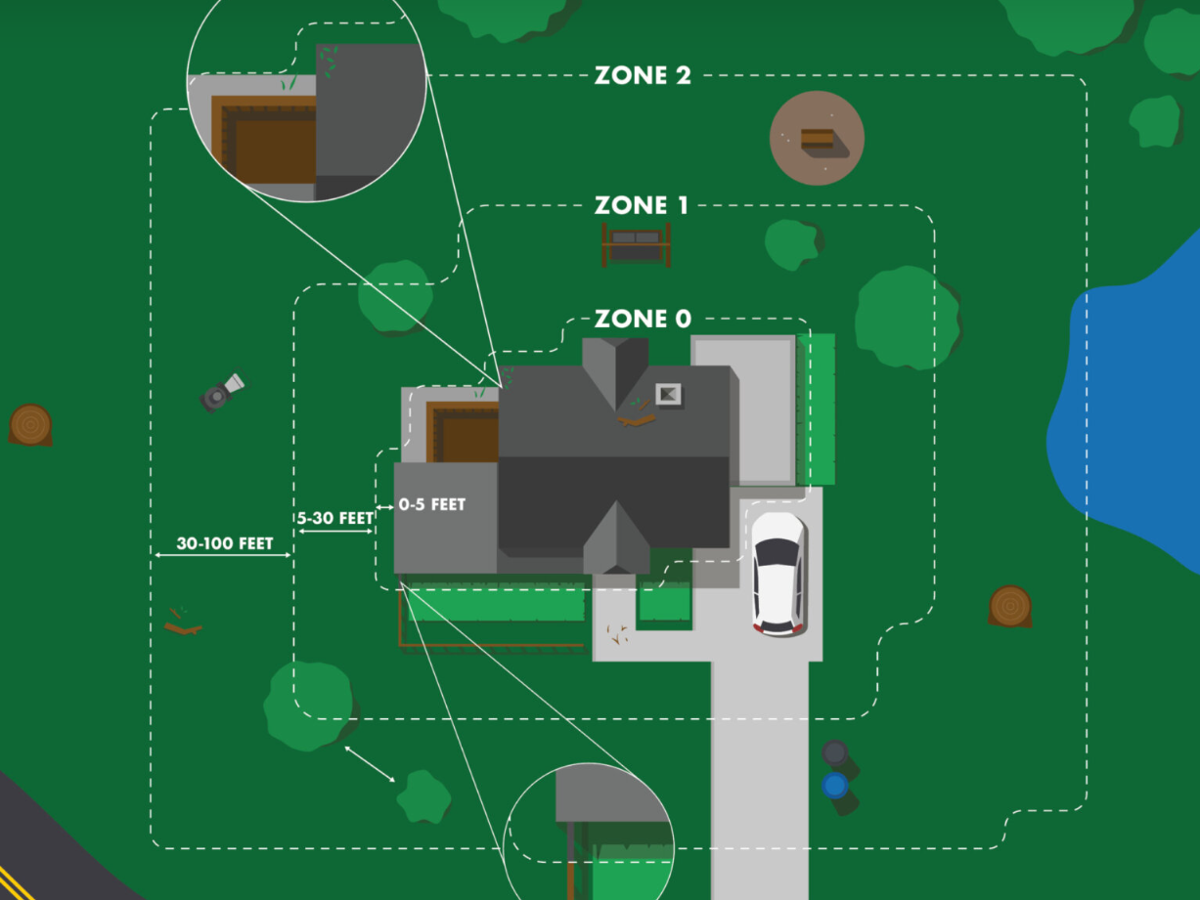
Preparing The Immediate Zone Around Your Home
In each zone, the intensity of vegetation management increases as you get closer to your home. The goal is to start at your house and work outward, reaching up to 100 feet or your property line.
Zone 0: Zone 0 extends 0- 5 feet from your home, focusing on intense fuel reduction, with no combustibles, to protect against ember attacks. Remove dead leaves and needles. Use drought tolerant fire resistive plants. No Fences, Trellises, Gazebos or play Structures.
Zones 1 & 2: These zones cover up to 100 feet around your home. They’re required by law and involve varying levels of vegetation management.

Slide 29
Examples of Immediate Zone Clearance around your House
It is important to keep a defensible space around your yard by:
No Combustible Material around the home within a 5-foot clearance zone, such as Fiber Door Mats, Storage Bins, Wooden Furniture, Propane Tanks, etc.
Trimming Trees.
No Fibrous Plants, Shrubbery or Trees. Succulents preferred no more than 2 feet in height.
Use of Succulents, and plants low to the ground.
No Organic Ground Cover like Bark. Decorative Rocks or Dirt is preferred.

Slide 30
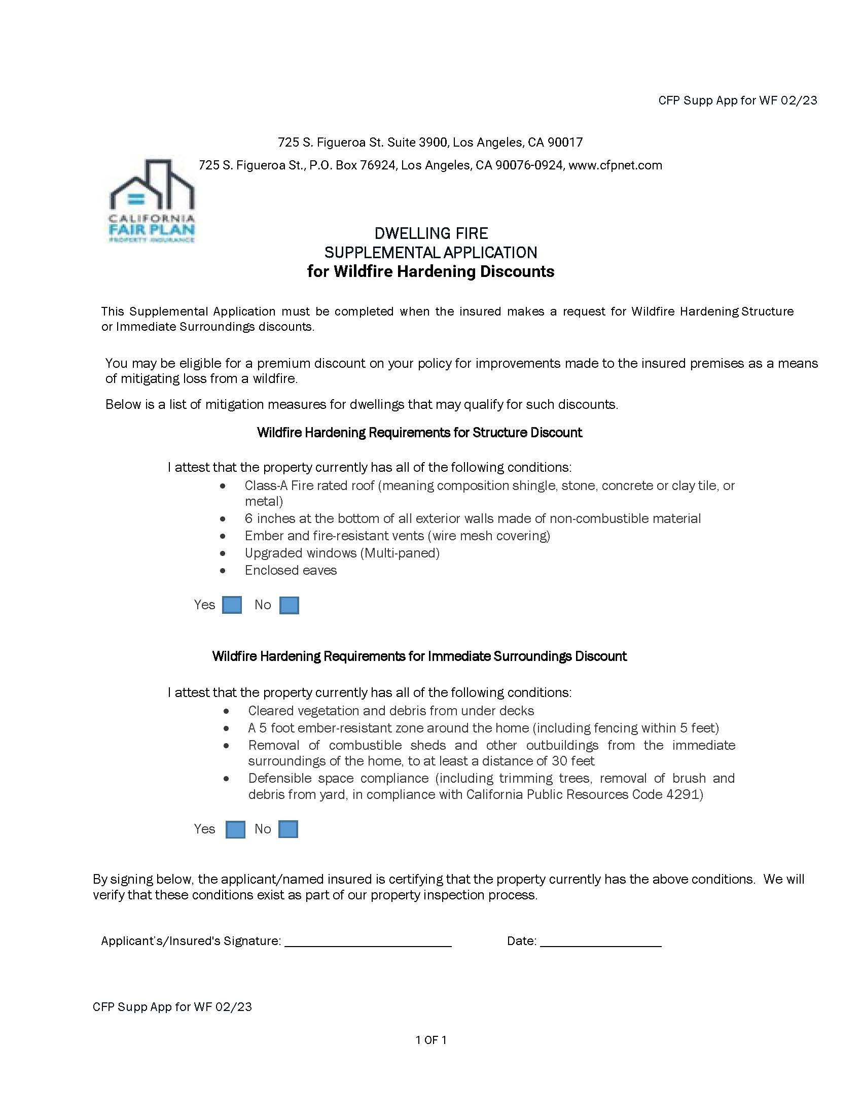
There is a “Possibility” of receiving a reduction in your insurance premiums by fire-hardening your home.
The California Fair Plan
An Example of a Dwelling Fire Application for Wildfire Hardening Discounts.

Slide 32
CONTINUING EFFORTS
This group is determined to spread the word about Fire Safety and to stay involved in the following actions:
Ongoing education on the importance of participating in AlertOC.
Continuing Presentations to HOAs and our Community Members.
Follow-up on discounts to the California Fair Plan participants.
Working with the State Insurance Commissioner to evaluate working with private insurers to provide discounts or policy retention for “fire hardened” homes.
Pursuit of State Grant Funding, for creating more defensible space and fire protection initiatives for HOA's, possibly lowering their insurance costs.
Make a concerted effort to work with City Police and Fire Departments in understanding emergency protocols.
Research the opportunity of becoming a Firewise Community.

Slide 33
Resources
The following website links provide information presented during this presentation.
Alert OC: www.AlertOC.org
Watch Duty: https://www.watchduty.org
OCFA – Ready/Set/Go: ocfa.org/RSG
Record of Home Inventory: https://www.insurance.ca.gov/flipbook/Home-Inventory2020
Top Ten Tips for Finding Insurance: https://www.insurance.ca.gov/01-consumers/105-type/5-residential
Vents
O’Hagin Vents - https://ohagin.com/products
BrandGuard Vents - https://www.brandguardvents.com
Vulcan Vents - https://vulcanvents.com
Gutters: Leaf Filter – https://LeafFilter.com
Please Note: Providing the above information on vendors products, is not considered an endorsement by this group, but strictly for informational purposes only.

Slide 34
QUESTIONS AND COMMENTS
Thank-you for attending this presentation!
We hope you have come away with some ideas and information to help protect your family and your home in the event of a Wildfire.

